Slide 1
CMSE 411 Final Project
Marius Nwobi
Jimmy Gray-Jones

Slide 2
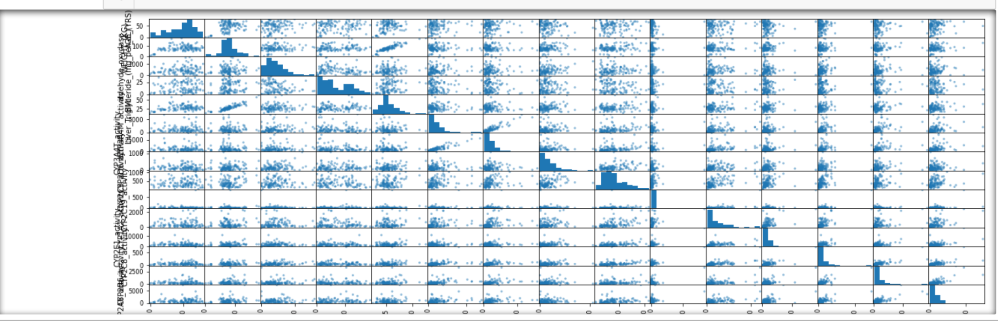
Getting a feel for the data
The bar plots shows the frequency (how many people weigh 50-100 etc) while the rest is just
The columns plotted against each other. This can help us to see if there are any clear correlations

Slide 3
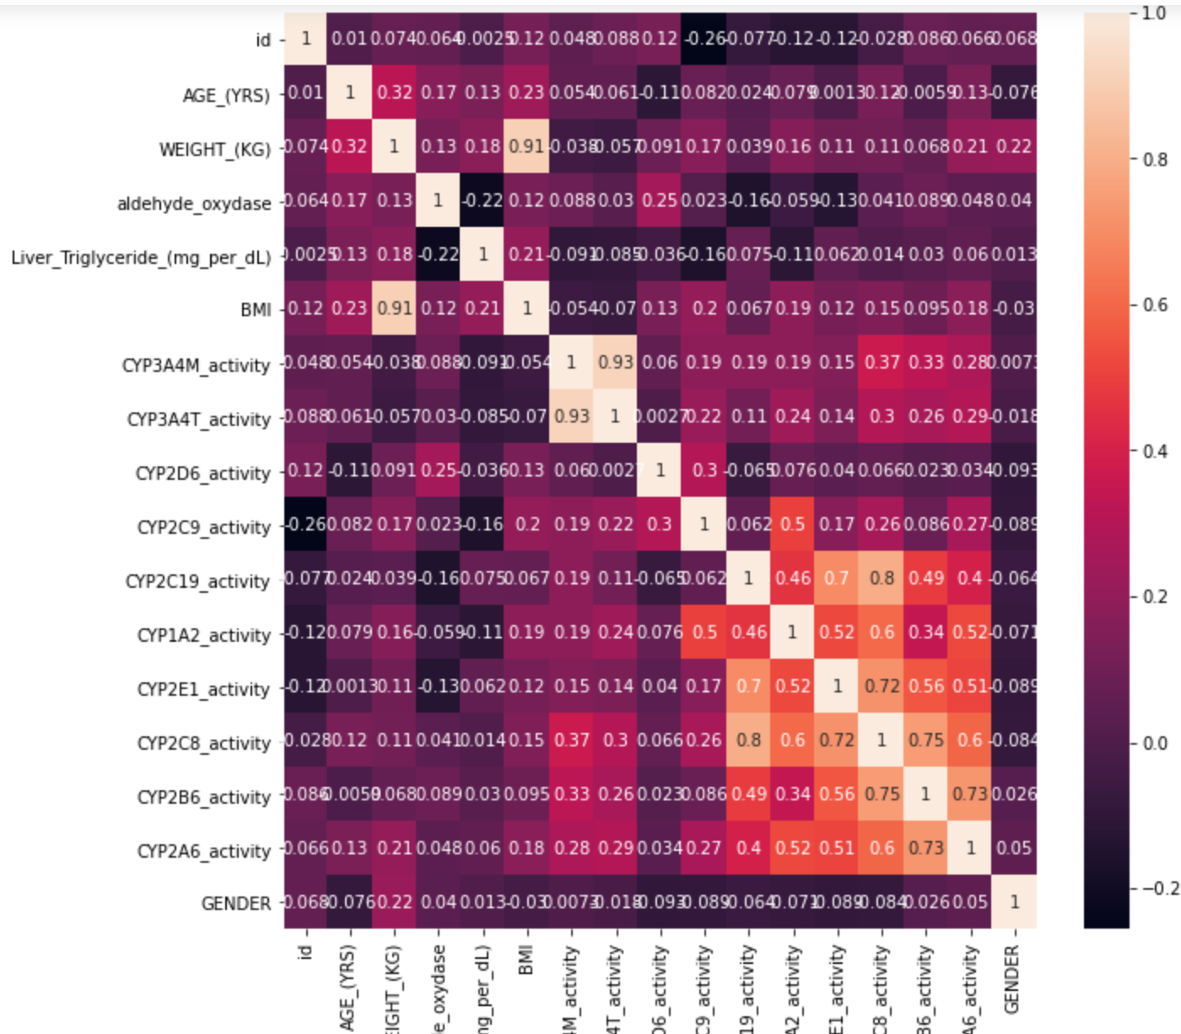
Clear visualizations
At first, we attempted to make a scatter matrix of the phenotype data to see what we were working with
We found however, that a heatmap (using seaborn) gave us a better visualization of the data

Slide 4
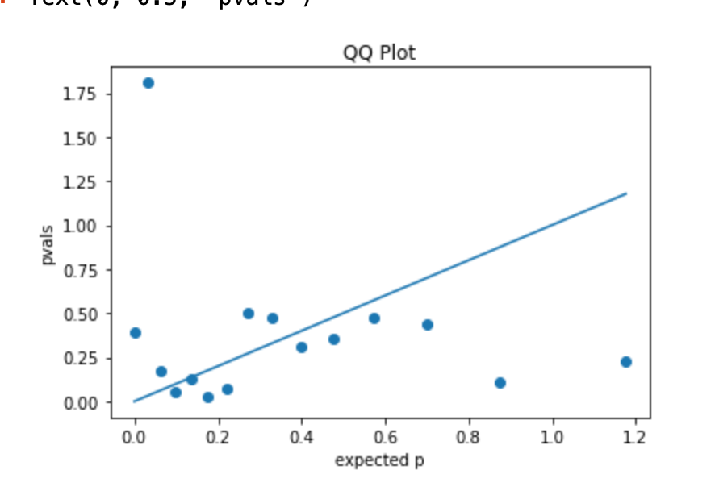
Linear Regression w/ statsmodel
We made a QQ plot to determine if there are any outliers when we calculated the pvalues of the genes.
We did linear regression based on predicting gender and got some pvalues.
Since we have some values that are outliers, we can infer that this data set does not share the same distribution throughout the data.

Slide 5
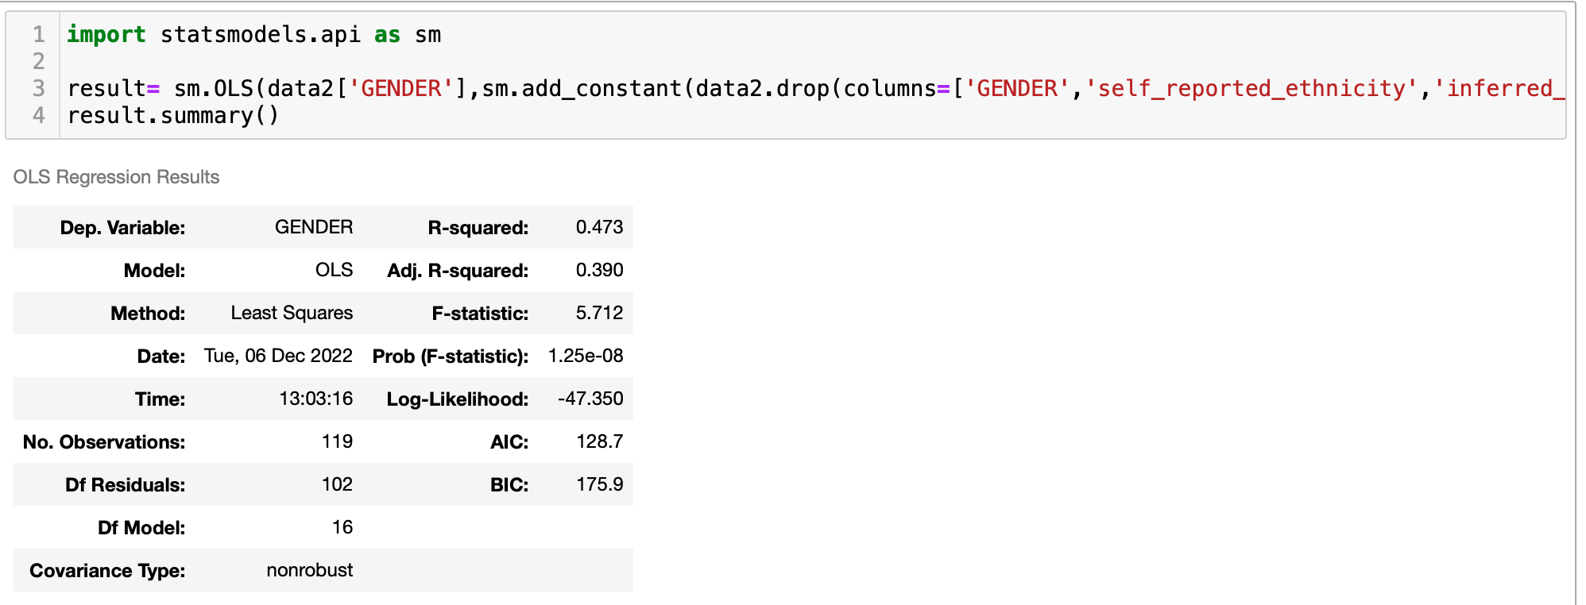
The code

Slide 6
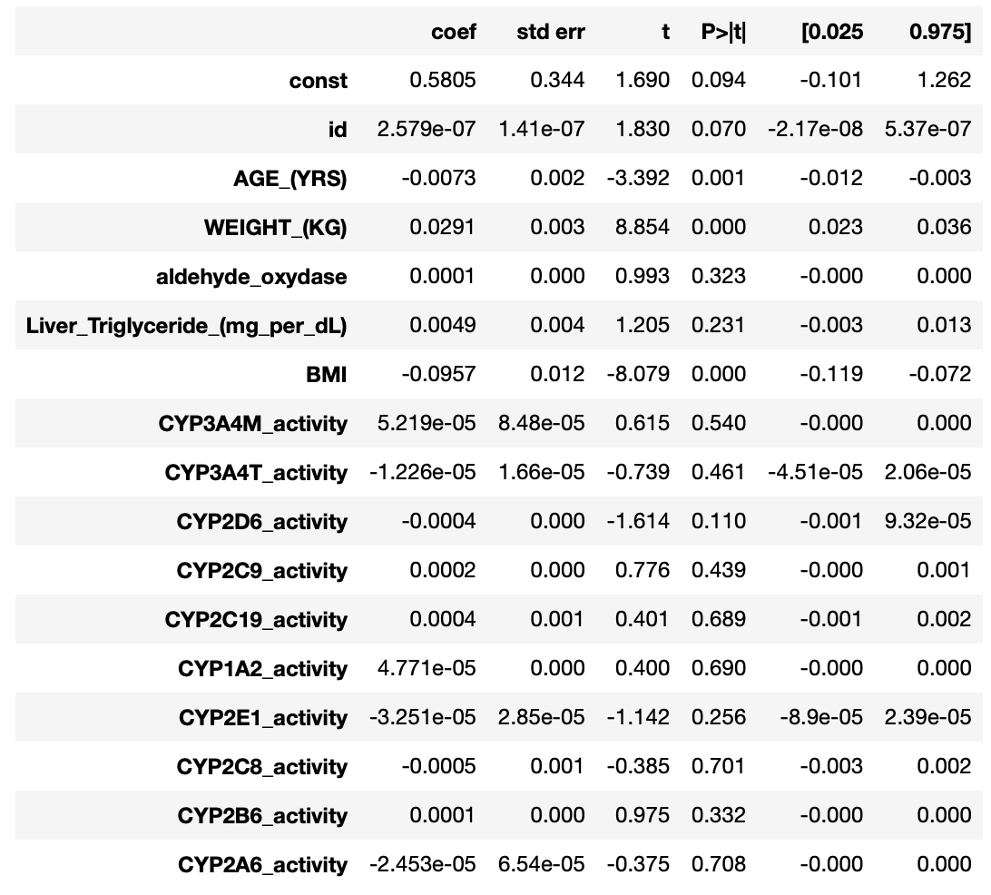
Results
Based on the pvals and T score, the weight, BMI, and age are strongly correlated in the determination of one’s gender given our phenotype data

Slide 7
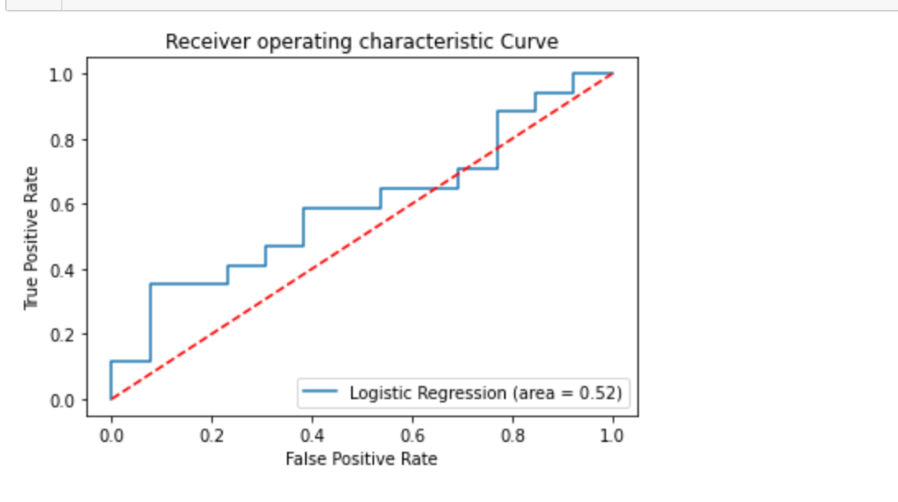
ROC Curve

Slide 8
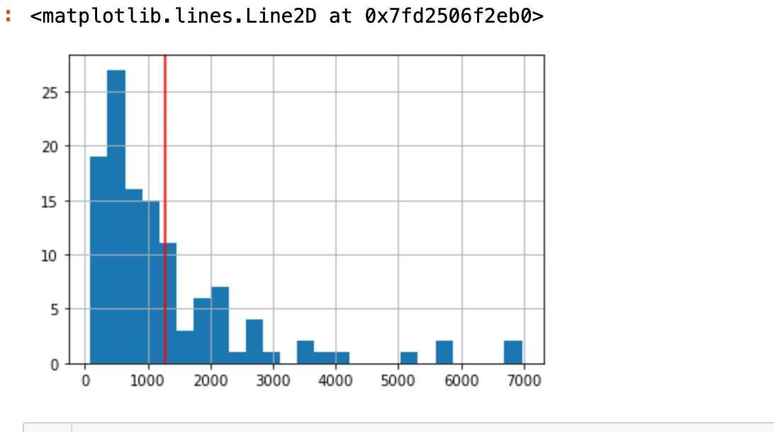
Whats associated with CYP3A4M_activity
We made this the cut off with the CYP3A4M_activity.
Anything over will be considered over active (1)and anything under will be considered regular(0)

Slide 9
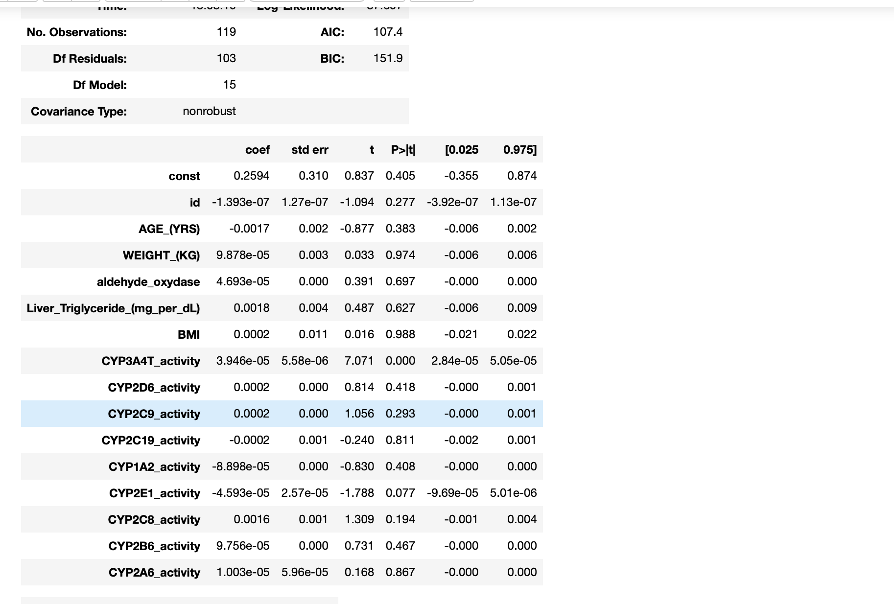
Multivariable Regression
We performed multivariable regression on our phenotypic data to see if any activities are associated with one another.
It turns out that even though gender doesn't affect gene activity, we do know that CYP3A4T_activity and CYP3A4M_activity are strongly related and CYP2B6_activity is loosely related based on p values and t score

Slide 10
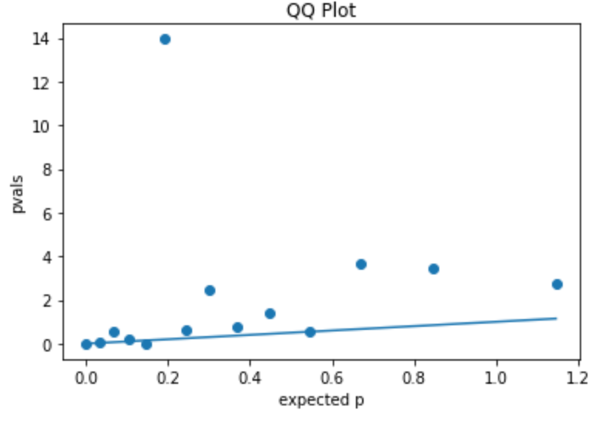
Performed linear regression
We performed linear regression once again to see if there were any outliers with our pvalues from what we expected
It turns out that there is; Most likely, the CYP3A4T_activity

Slide 11
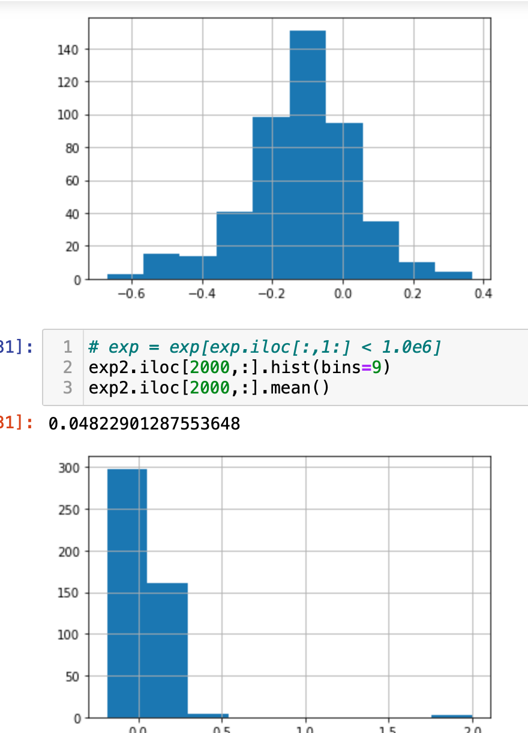
Difference in gene expression
Showing that there is a diffenrce when it come to gene expression, everything isn't equally distributed and each type of gene expressions are not distributed the same way.
Showing that there are significant genes in this data set and they do go against our null hypothesis that everything is expressed the same or similar.

Slide 12
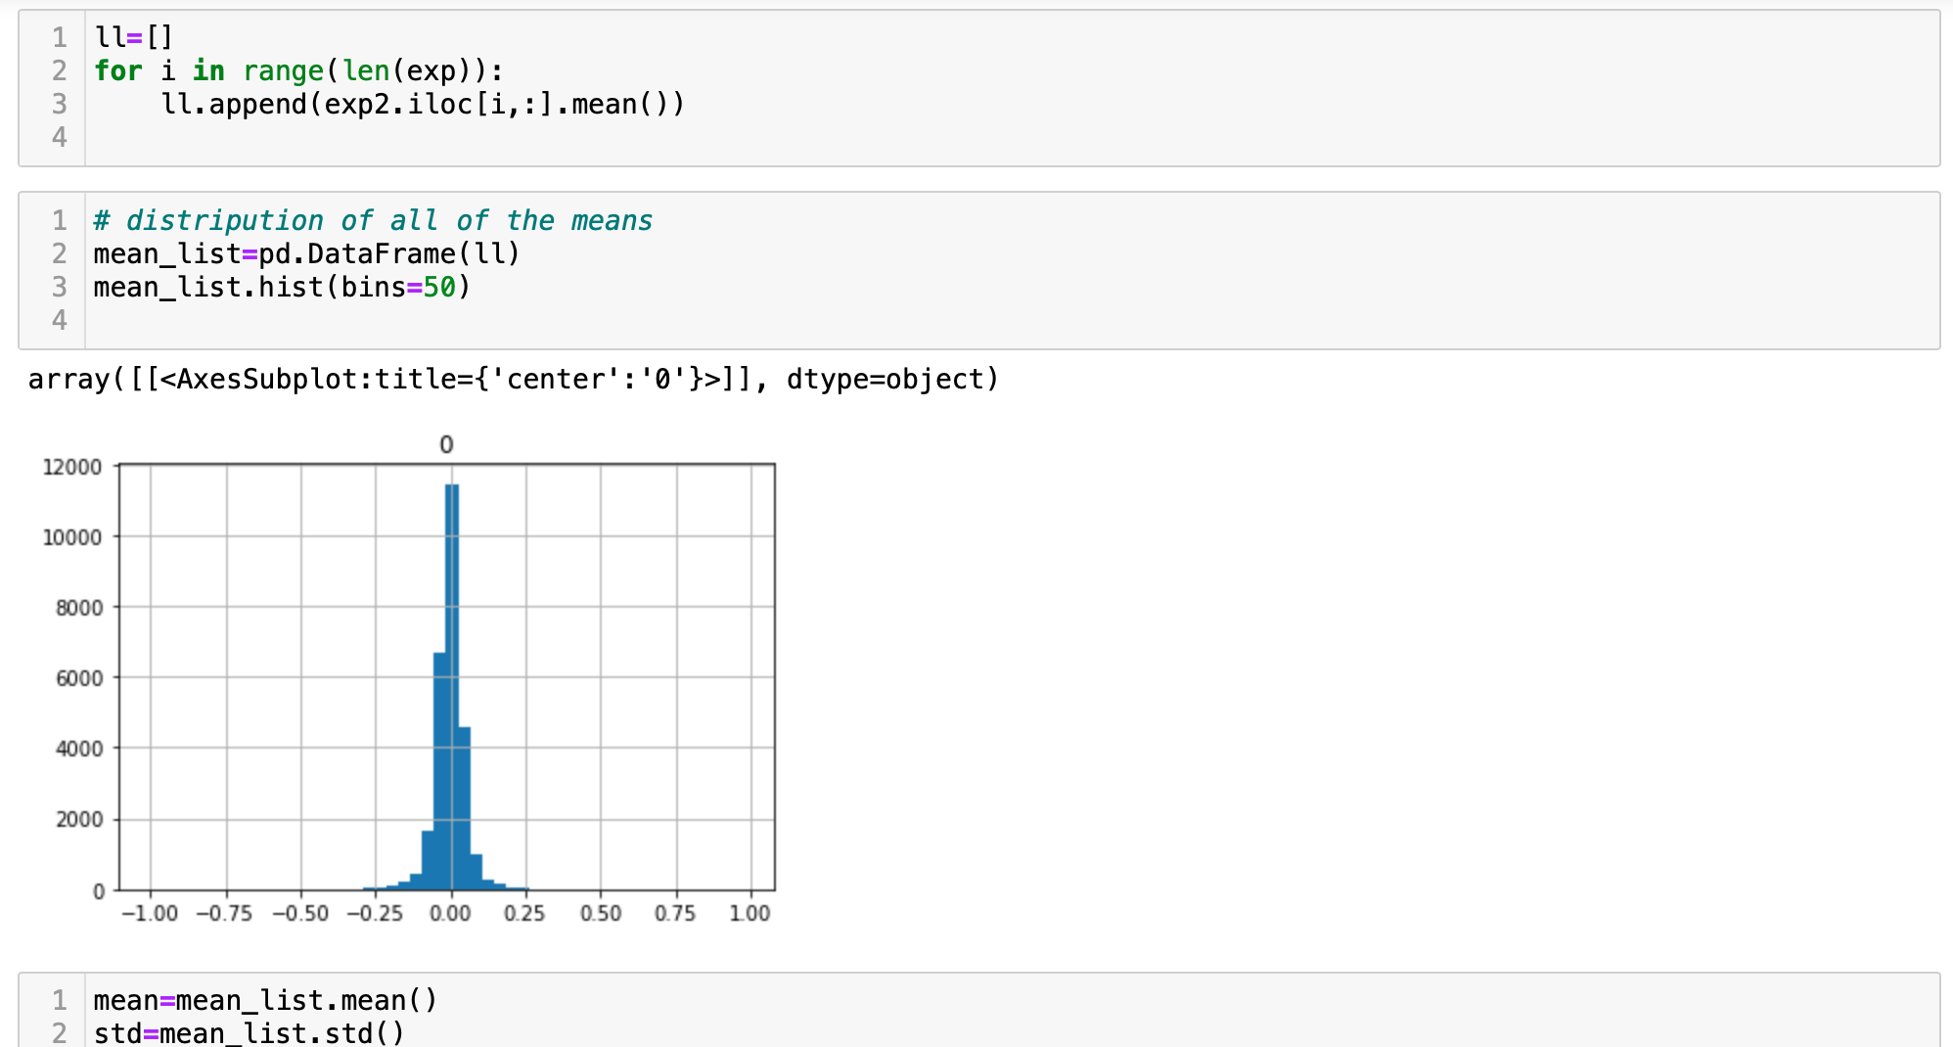
Confusion
Histogram of means for each expression but since it looks binomial we can assume that there are no outliers, but there are some genes that are more expressed than others.
Knowing this though we didnt know where to go from there to figure out the over expressed and under expressed genes

Slide 13
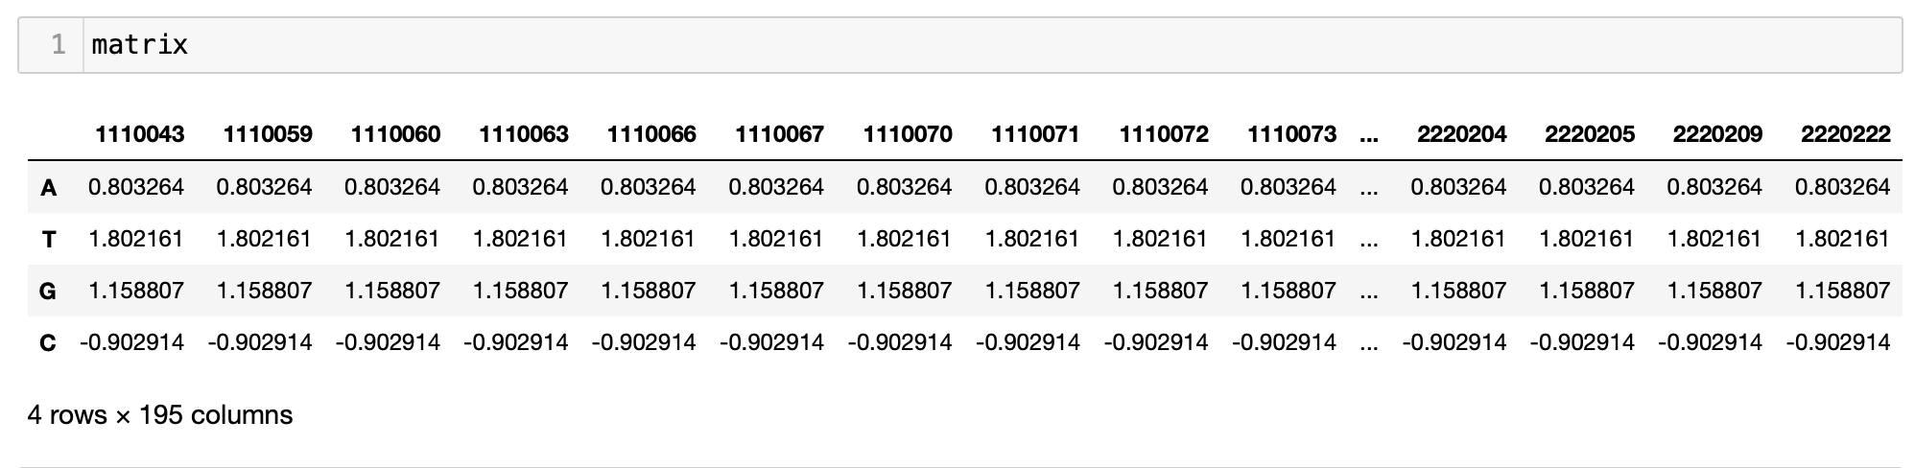
Position weight matrix (PWM)

Slide 14
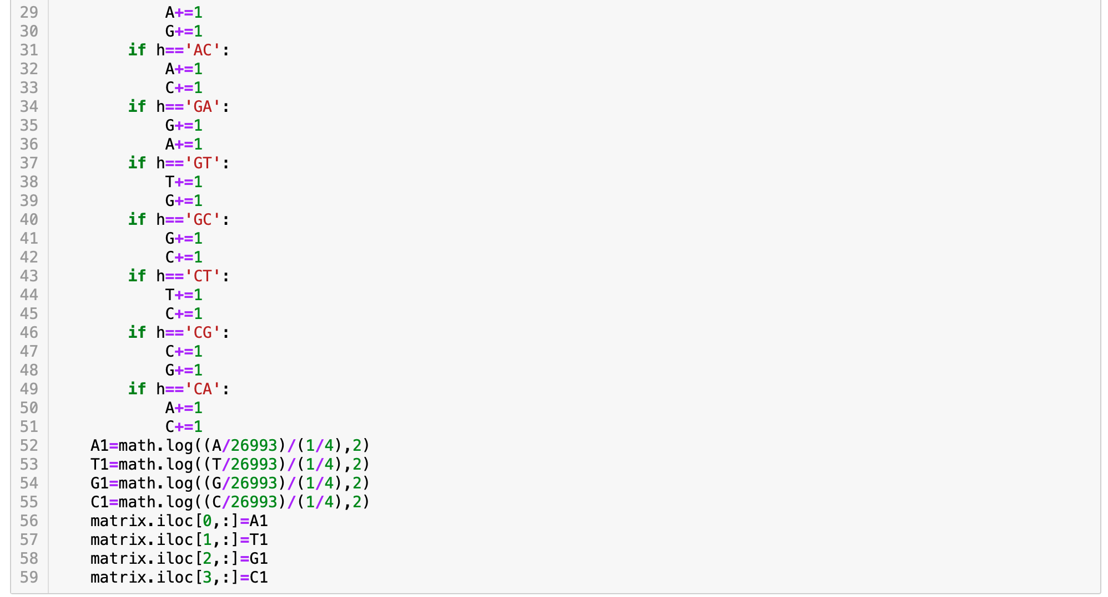
PWM Code

Slide 15
Conclusions
In conclusion we were able to make a PWM to conclude that T and G are the more present, figure out what genes are associated with CYP3A4M activity via multi variable regression,performed linear regression to see if there are any expressions associated with males or females, and used QQ plots to visualize our results.

